Slide 1
Lecture 10: Intro to Classes
Copyright (c) Pearson 2013.
All rights reserved.

Slide 2
Classes and objects
class: A program entity that represents either:
  1. A client/driver class: Has main method. Runs the program.
  2. Module: Utility class with useful methods, e.g. Math class.
  3. A template for a new type of objects.
  The Car class is a template for creating Car objects.
object: An entity that combines state(data) and behavior(methods).
  object-oriented programming (OOP): Programs that perform their behavior as interactions between objects.

Slide 3
Classes and objects
Example:
The Ipod class provides the template or blueprint for state(data) and behavior(methods) of an ipod object.
Its state or data can include the current song, current volume and battery life. Its behavior or methods can include change song, change volume, turn on/off, etc…
Two different ipod objects can have different states/data. However, their template share the same implementation/code.

Slide 4


Blueprint analogy
iPod blueprint
state:
current song
volume
battery life
behavior:
power on/off
change station/song
change volume
choose random song
creates
iPod #1
state:
song = ”Uptown Funk"
volume = 17
battery life = 2.5 hrs
behavior:
power on/off
change station/song
change volume
choose random song
iPod #2
state:
song = ”You make me wanna"
volume = 9
battery life = 3.41 hrs
behavior:
power on/off
change station/song
change volume
choose random song
iPod #3
state:
song = ”Trumpets"
volume = 24
battery life = 1.8 hrs
behavior:
power on/off
change station/song
change volume
choose random song

Slide 5
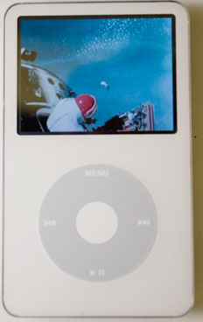
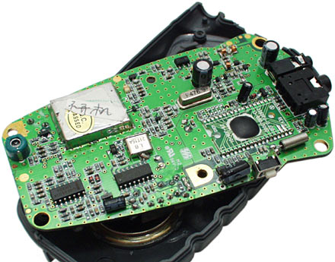
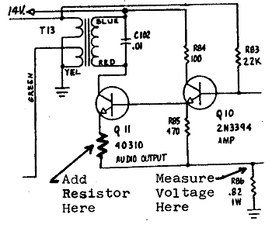
Abstraction
abstraction: A distancing between ideas and details.
  We can use objects without knowing how they work.
abstraction in an iPod:
  You understand its external behavior (buttons, screen).
  You don't understand its inner details, and you don't need to.

Slide 6
Abstraction
abstraction: A distancing between ideas and details.
  We can use objects without knowing how they work.
abstraction in the String class:
    We don’t understand/see how the methods substring, indexOf, length, toLowerCase, etc… work but we still can use it.

Slide 7
More Examples
Suppose you are writing a RPG(role playing game). What are some classes and their corresponding objects?
Example:
The Character Class represents characters in the game.
State/Data: String name, int numberOfLives, boolean isAlien.
Behavior/Methods: shoot(), runLeft(), runRight(), jump().
Objects:
Character player1, player2; //declaring objects of type Character
Character enemy1, enemy2;

Slide 8
More Examples
Your game might have more than one classes.
Classes: Character, Boss, MysteryBox, Obstacle.
Objects:
Boss level1, level2;
MysteryBox yellow; // give player 3 extra lives
MysteryBox red; // give player 100 coins
Obstacle wall; //immovable
Obstacle poison; // kills player

Slide 9
More Examples
Suppose you are writing a database program to store students records.
Class: Student
State/Data: String name, String address, int ID, double gpa.
Behavior/Methods: printStudentInfo(), changeAddress(String newAddress), updateGPA(double newgpa).
Objects:
Student s1,s2;

Slide 10
Object state/data: Fields

Slide 11
Point class, version 1
  public class Point {
  int x;
  int y;
  }
  Save this code into a file named Point.java.
The above code creates a new type named Point.
  Each Point object contains two pieces of data:
    an int named x, and
    an int named y.
    int variables x and y are the fields of the class Point
  Point objects do not contain any behavior (yet).

Slide 12
Fields
field: A variable inside an object that is part of its state.
  Each object has its own copy of each field.
Declaration syntax:
  type name;
  Example:
  public class Student {
  String name; // each Student object has a
  double gpa; // name and a gpa field
  }

Slide 13
Accessing fields
Other classes can access/modify an object's fields.
  access: variable.field
  modify: variable.field = value;
Example: (In class with main method)
  public static void main(String[] args)
  {
  Point p1 = new Point();
  Point p2 = new Point();
  System.out.println("the x-coord is " + p1.x); // access
  p2.y = 13; // modify

Slide 14
A class and its client
Point.java is not, by itself, a runnable program. It doesn’t have a main method.
  A class can be used by driver/client programs.
Point.java (class of objects)
public class Point {
int x;
int y;
}
PointMain.java (client program)
public class PointMain {
main(String args) {
Point p1 = new Point();
p1.x = 7;
p1.y = 2;
Point p2 = new Point();
p2.x = 4;
p2.y = 3;
...
}
}
x | 7 | y | 2
x | 4 | y | 3

Slide 15
PointMain client example
public class PointMain {
public static void main(String[] args) {
// create two Point objects
Point p1 = new Point();
p1.x = 0, p1.y = 2;
Point p2 = new Point();
p2.x = 3, p2.y = 7;
System.out.println(p1.x + ", " + p1.y); // 0, 2
// move p2 and then print it
p2.x += 2;
p2.y++;
System.out.println(p2.x + ", " + p2.y); // 5, 8
}
}

Slide 16
Object behavior: Methods

Slide 17
Instance methods
instance method (or object method): Exists inside each object of a class and gives behavior to each object.
  public type name(parameters) {
  statements;
  }
  same syntax as static methods, but without static keyword
  Example:
  public void shout() {
  System.out.println("HELLO THERE!");
  }

Slide 18
Instance methods
We have used instance methods before.
  public class String{
  …
  public int length() {…}
  public String substring(int index){…}
  public int indexOf(String str){…}
  }
  Example: In our driver class.
  String str=“This is a string.”, str2=“hello”;
  System.out.println(str2.length()); //5
  System.out.println(str.length()); //16
  int index=str.indexOf(“is”); //2

Slide 19
Instance method example
  public class Point {
  int x;
  int y;
  // print this Point object.
  public void printPoint() {
  ...
  }
  }
  The printPoint method no longer has a Point p parameter.
  How will the method know which point to print?
    How will the method access that point's x/y data?

Slide 20
Instance method example
  public class Point {
  int x;
  int y;
  // print this Point object.
  public void printPoint() {
  ...
  }
  }
  The printPoint method no longer has a Point p parameter.
  How will the method know which point to print?
    How will the method access that point's x/y data?

Slide 21
Implicit Parameter
Each Point object has its own copy of the draw method, which operates on that object's state:
  Point p1 = new Point();
  p1.x = 7;
  p1.y = 2;
  p1.setLocation(-3,8);
  p1.tranlate(5,-2);
  Point p2 = new Point();
  p2.x = 4;
  p2.y = 3;
  double d=p2.distance(p1);
  p1.printPoint();
  p2.printPoint();
p1
public void printPoint() {
// this code can see p1's x and y
}
x | 2 | y | 6
public void printPoint() {
// this code can see p2's x and y
}
x | 4 | y | 3
p2

Slide 22
The implicit parameter
implicit parameter:
The object on which an instance method is called.
  During the call p1.printPoint();
  the object referred to by p1 is the implicit parameter.
  During the call p2.printPoint();
  the object referred to by p2 is the implicit parameter.
  The instance method can refer to that object's fields.
    We say that it executes in the context of a particular object.
    printPoint can refer to the x and y of the object it was called on.

Slide 23
Kinds of methods
accessor: A method that lets clients examine object state.
  Examples: distance, distanceFromOrigin
  often has a non-void return type
mutator: A method that modifies an object's state.
  Examples: setLocation, translate
  often has a void return type

Slide 24
Mutator method questions
Write a method setLocation that changes a Point's location to the (x, y) values passed.
Write a method translate that changes a Point's location by a given dx, dy amount.
  Modify the Point and client code to use these methods.

Slide 25
Mutator method answers
public void setLocation(int newX, int newY) {
x = newX;
y = newY;
}
public void translate(int dx, int dy) {
x = x + dx;
y = y + dy;
}
// alternative solution that utilizes setLocation
public void translate(int dx, int dy) {
setLocation(x + dx, y + dy);
}

Slide 26
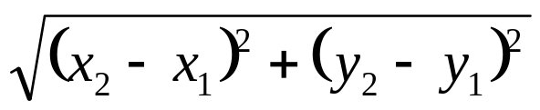
Accessor method questions
Write a method distance that computes the distance between a Point and another Point parameter.
Use the formula:
Write a method distanceFromOrigin that returns the distance between a Point and the origin, (0, 0).
  Modify the client code to use these methods.

Slide 27
Accessor method answers
public double distance(Point other) {
int dx = x - other.x;
int dy = y - other.y;
return Math.sqrt(dx * dx + dy * dy);
}
public double distanceFromOrigin() {
return Math.sqrt(x * x + y * y);
}
// alternative solution that uses distance
public double distanceFromOrigin() {
Point origin = new Point();
return distance(origin);
}

Slide 28
Lab
Rewrite the Point class with all of the methods in this lecture. Save it as Point.java. Then write a driver(different) class called PointTester with the main method. Create some point objects in the main method. Print out objects’ data by accessing its fields and by calling its methods.

Slide 29
Lab 2
Write the Circle class. This class has the following field variables(data/state): double x, double y, double radius, String color.
It has the following instance methods: getArea(), boolean isOnCircle(double a, double b), setColor(String str), translate(double dx, double dy), doubleRadius().
Use the same driver class from the previous lab to test the Circle class. Create multiple circles and call all of the methods.
Notice that the same drive class can run and test both the Point and Circle classes.

Slide 30
Term 1 Quiz
This quiz will focus on conditional statements (if, else if, nested else if), loops(for and while) and Strings.
It will be on codingbat. You’ll have 25 minutes to complete 2-3 problems.

Slide 31
String.valueOf
One of the problems will require you to use String.valueOf(int x), which will return the String form of an integer. For example, String.valueOf(123) will return “123” as a String.
What is the output?
String temp=“”;
for(int i=8;i<13;i++)
temp+=String.valueOf(i);
System.out.println(temp);
Answer: 89101112

